Slide 1
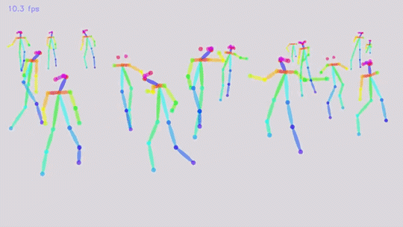
Realtime Multi-Person Pose Estimation
Zhe Cao, Tomas Simon, Shih-En Wei, and Yaser Sheikh (2017).
arXiv:1611.08050v2
6-min. Paper Presentation by Brandon Kessler, Maddy Schiappa, and Jack P. Oakley

Slide 2
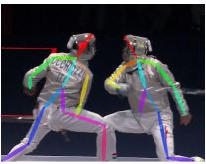
Goal of the Paper
The goal presented in the paper is to improve upon the current (at the time) methods of multiple human pose detection and estimation.
What’s Been Done Previously:
Finding individuals’ body parts was the main focus of localizing anatomical key points
Single person detection and pose estimation from top-down
Single person detection and pose estimation from bottom-up
Image dependent pairwise scores used with stronger ResNet based part detectors
What’s New:
Part Affinity Fields are used for a bottom-up representation of association scores
Simultaneous inference of bottom-up representations of detection and association
Notes:
Slide Purpose: Understand the goal of the paper: What is new, and what was done previously as described in the paper. (2%)
Notes for First bullet on Left side -
Challenges of Multiple People Pose Inference:
Unknown amount of people
People can be various sizes
People can be at any coordinate in image
Social interactions interfere spatially with much complexity
Notes for Second bullet on Left side -
Single person top-down approach:
Directly leverages existing techniques for single person estimation
Suffers from early commitment
Prone to fail when people are in close proximity
No recovery if there’s a failure to detect a person
Computational cost is proportional to the number of people
Notes for Third bullet on Left side -
Single person bottom-up approach:
Offers robustness to early commitment
Has potential to reduce runtime complexity from amount of people in image
Does not use global cues from other body parts or people
Loses efficiency gains during final parse due to costly global inference
Average processing time took several hours for solving the integer linear programming problem over a fully connected graph
Notes for Fourth bullet on Left side -
Stronger ResNet detectors:
Takes several minutes per image
Number of part proposals are limited
Pairwise representations are difficult to regress with precision
Separate logistic regression is required
Notes for First bullet on Right side -
PAFs and Association Scores:
2D vector field
Encodes location and orientation of limbs over domain of image
Notes for Second bullet on Right side -
Simultaneous inference of Detection and Association:
Encodes the global context well enough to allow greedy parsing to obtain high quality results
Fraction of computational cost

Slide 3
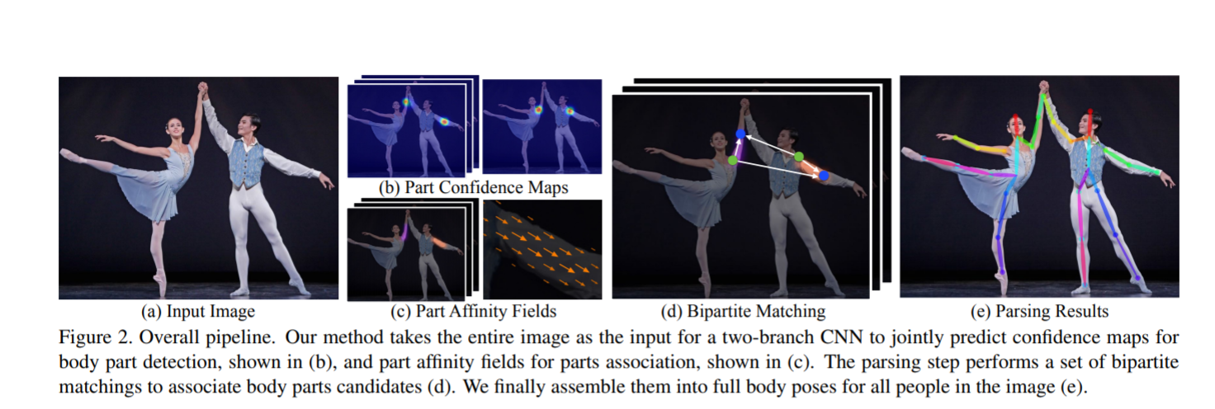
Solution
Simultaneous Detection and Association
Simultaneous prediction of 2D confidence maps and part affinity fields (encoding of the degree of association between parts).

Slide 4
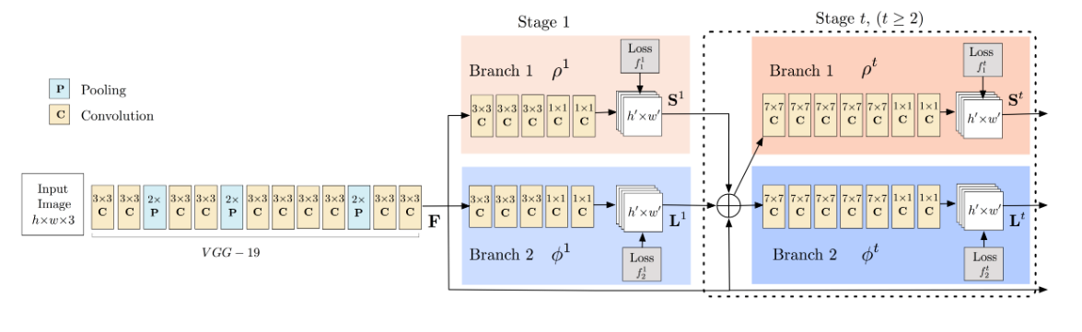
Architecture
First runs through VGG-19 CNN to generate feature mapping
Runs through two-branch CNN
One predicting confidence maps for keypoint
One predicting affinity fields for parts associations
A set of bipartite matchings is used to match key points to body parts.
Assembles body part associations into full body poses
Notes:
Slide Purpose: What is the overall solution and the architecture presented in the paper, (2%)
Notes:
1. Takes a color image as input and produces, as output, the 2D locations of anatomical key points for each person in the image. First, a feedforward network simultaneously predicts a set of 2D confidence maps of body part locations and a set of 2D vector fields of part affinities, which encode the degree of association between parts.
1.1 Each branch is an iterative prediction architecture, which refines the predictions over successive stages, with intermediate supervision at each stage. Part affinity fields preserve both location and orientation information across the region of support of the limb.
1.2 At the first stage, the network produces a set of detection confidence maps and a set of part affinity fields, which are the CNNs for inference at Stage 1. In each subsequent stage, the predictions from both branches in the previous stage, along with the original image features, are concatenated and used to produce refined predictions, which are the CNNs for inference at Stage t.
2. Non-maximum suppression is used on the detection confidence maps to obtain a discrete set of part candidate locations. These part candidates define a large set of possible limbs. Each candidate limb is scored using a line integral computation on the PAF. Each edge is weighted by the part affinity aggregate (an equation.). A matching in a bipartite graph is a subset of the edges chosen in such a way that no two edges share a node.
3. A minimal number of edges is chosen to obtain a spanning tree skeleton of human pose rather than using the complete graph, the matching problem is further decomposed into a set of bipartite matching subproblems and the matching in adjacent tree nodes is determined independently. Minimal greedy inference well-approximates the global solution at a fraction of the computational cost. The reason is that the relationship between adjacent tree nodes is modeled explicitly by PAFs, but internally, the relationship between nonadjacent tree nodes is implicitly modeled by the CNN. This property emerges because the CNN is trained with a large receptive field, and PAFs from non-adjacent tree nodes also influence the predicted PAF.
PAF: Part Affinity Field

Slide 5
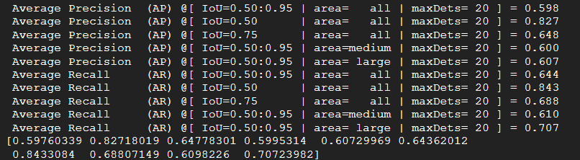
Were We Able To Replicate?
Reported on paper (VGG19) | mAP in this repo (VGG19) | Our Implementation
0.577 | 0.598 | 0.5976
Our GitHub Code
Notes:
Slide Purpose: Check for the code of the paper on GitHub or on another online platform and download and run the code to generate author's results by yourself and report the new data format you used and if you can replicate their results as reported in their paper. (4%)

Slide 6
Metrics
MPII Multi-Person Evaluation
Mean Average Precision (mAP) of all body parts
based on the percentage of correct keypoints (PCKh) threshold (Andriluka et al., 2014)
Matching threshold as 50% of the head segment length.
Coco Evaluation
Object Key Point Similarity (OKS) + MAP
For more see: http://cocodataset.org/#keypoints-eval
Calculated from scale of the person and the distance between predicted points and ground-truth points.
Notes:
mAP: It is the average of the maximum precisions at different recall values.
Area under precision-recall graph

Slide 7
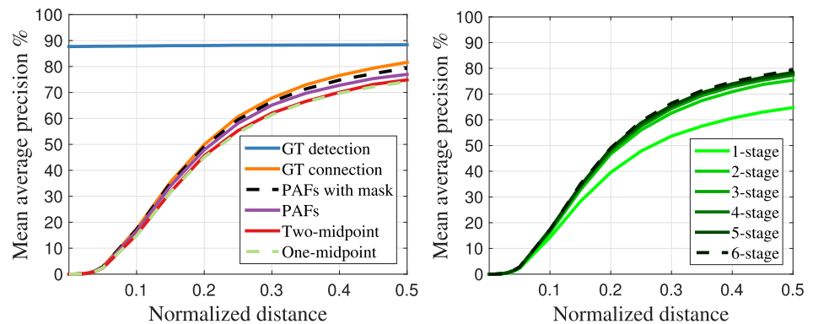
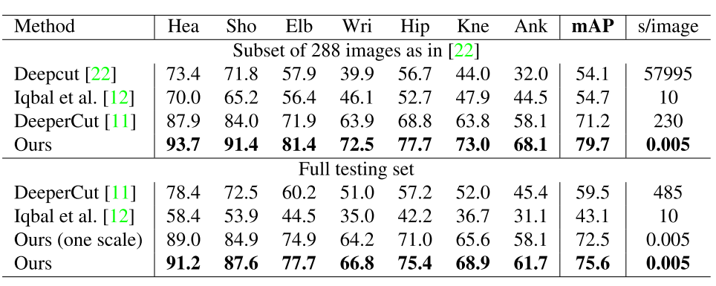
Reported Results
MPII Multi-Person Dataset:
compared to other approaches on the same subset of 288 testing images.
Base model outperforms all previous state-of-the-art bottom-up models by 8.5% mAP and is 6 orders of magnitude less
Using a 3 scale search increases performance to 75.6% mAP
Notes:
Slide Purpose: What are the reported results, and how they are presented (show the figures, tables, etc). (2%)

Slide 8
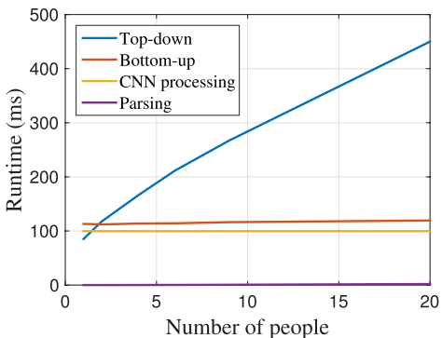
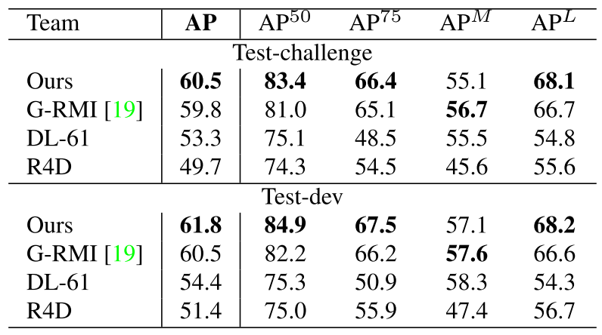
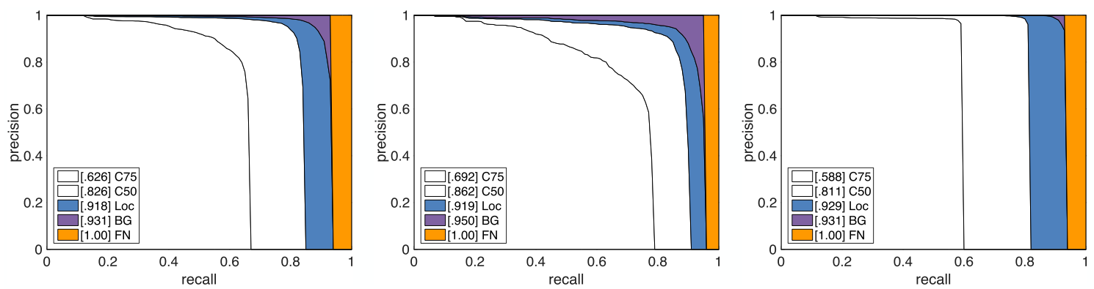
Reported Results
COCO 2016 Keypoints Challenge:
mAP is used over 10 Object Keypoint Similarity (OKS) thresholds.
Calculated from scale of person and distance between predicted points and GT points
This method has lower accuracy than other top-down methods of smaller scales.
Achieved an upper bound for top-down approach using CPM, which got 62.7% mAP.
This drops 10% when using Single Shot MultiBox Detector
Bottom-up method achieves 58.4% mAP
Gain overall 2.6% mAP when applying a single person CPM on each rescaled region of estimated persons parsed by this method
Notes:
Slide Purpose: What are the reported results, and how they are presented (show the figures, tables, etc). (2%)
Notes:
OKS plays the same role as IoU in object detection.
The reason is that this method has to deal with a much larger scale range spanned by all people in the image in one shot. In contrast, top-down methods can rescale the patch of each detected area to a larger size and thus suffer less degradation at smaller scales.
CPM: Convolutional Pose Machine

Slide 9
References
Mykhaylo Andriluka, Leonid Pishchulin, Peter Gehler, Bernt Schiele; The IEEE Conference on Computer Vision and Pattern Recognition (CVPR), 2014, pp. 3686-3693
Zhe Cao, Tomas Simon, Shih-En Wei, Yaser Sheikh (2017). Realtime Multi-Person 2D Pose Estimation using Part Affinity Fields. https://arxiv.org/abs/1611.08050

Slide 10
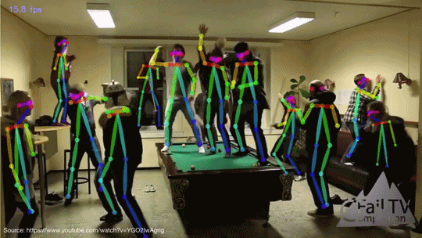
Thank you, questions?
Notes:
Answer questions first, then if there is still time left (Not likely) we can play the video for the remaining time.

